Slide 1
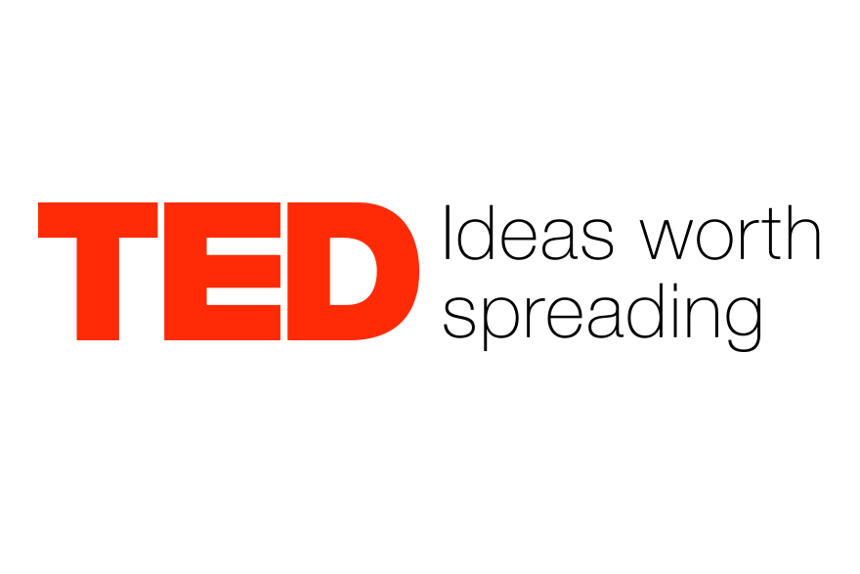
… and data worth analysing?
Alina Kereszt Cultural Data Science 2022

Slide 2

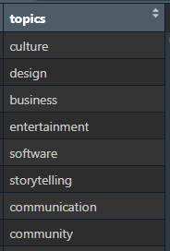




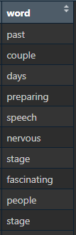

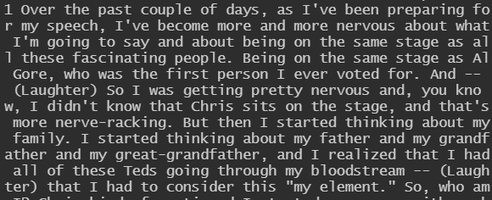



What is TED?
TED is a nonprofit devoted to spreading ideas, usually in the form of short, powerful talks (18 minutes or less).
Data provenance
Kaggle (Yevhen Herasimov)
Data wrangling
Wrong encodings
Multiple data points in single cell
Cleaning and tokenization

Slide 3
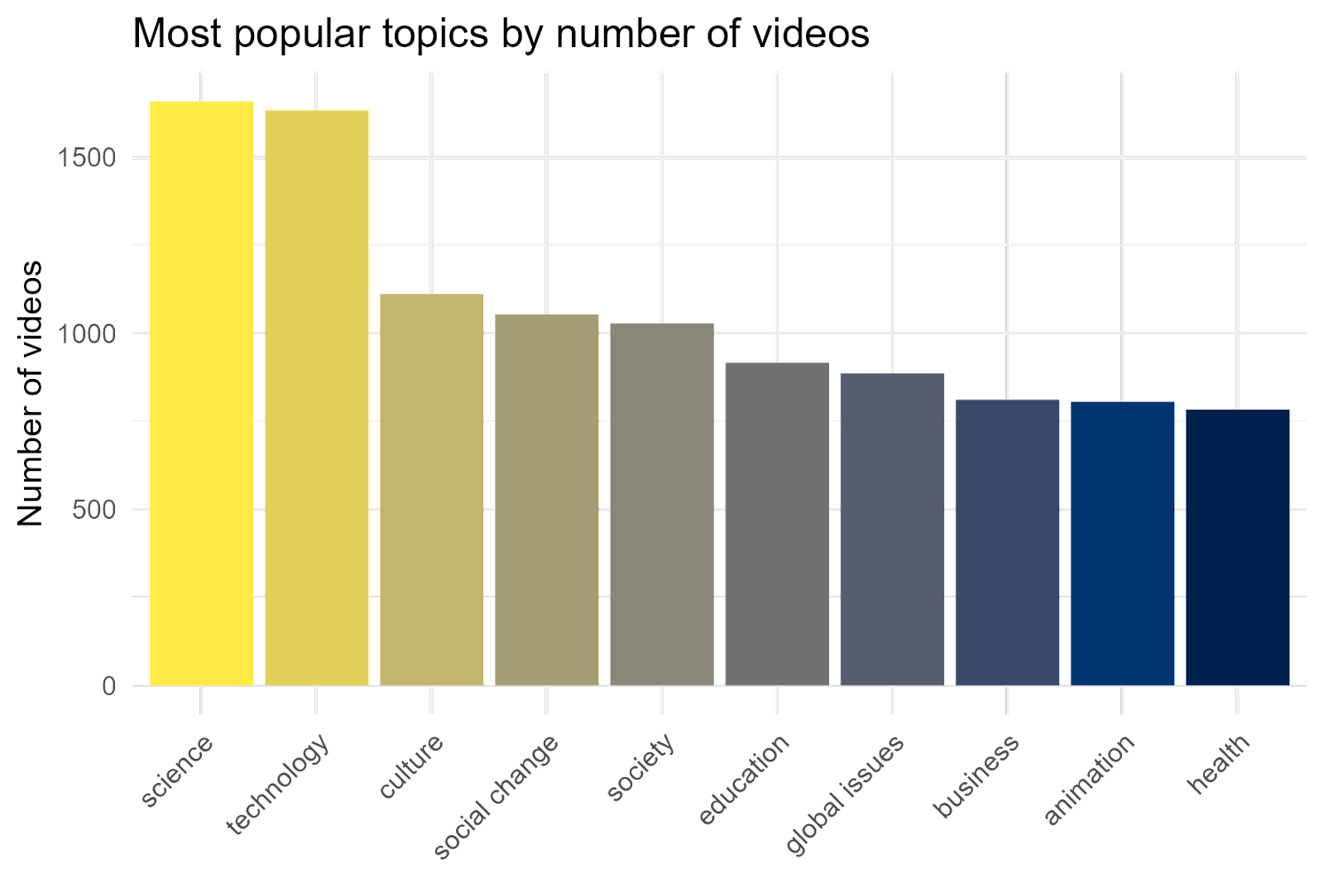
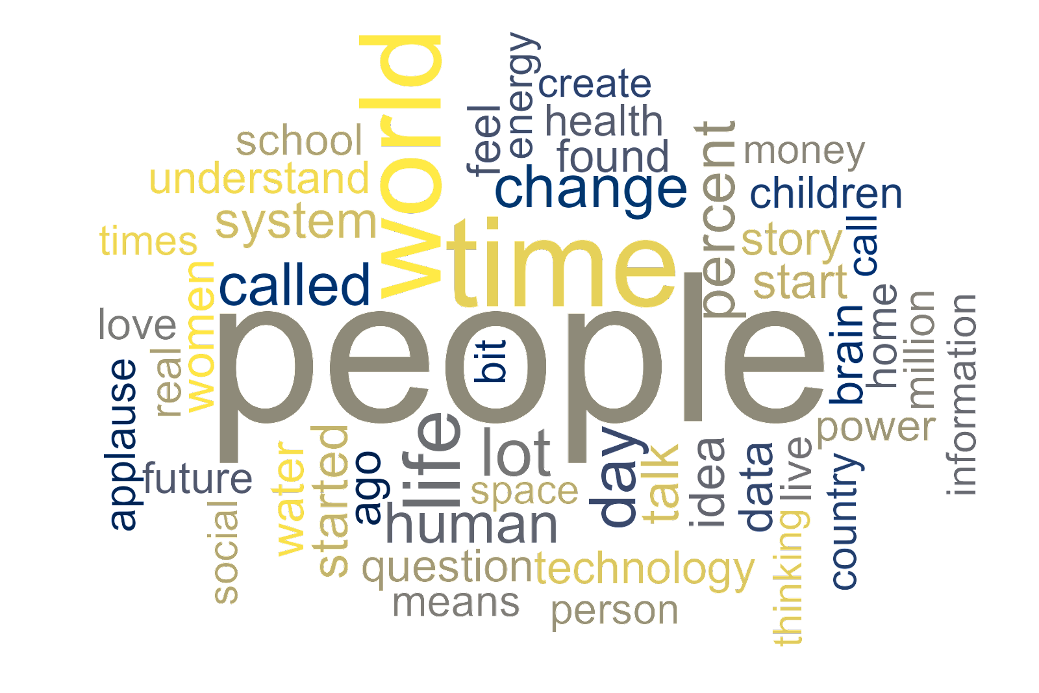
What are TED-talks even about?
Is there a specific vocabulary the speakers prefer to use?

Slide 4
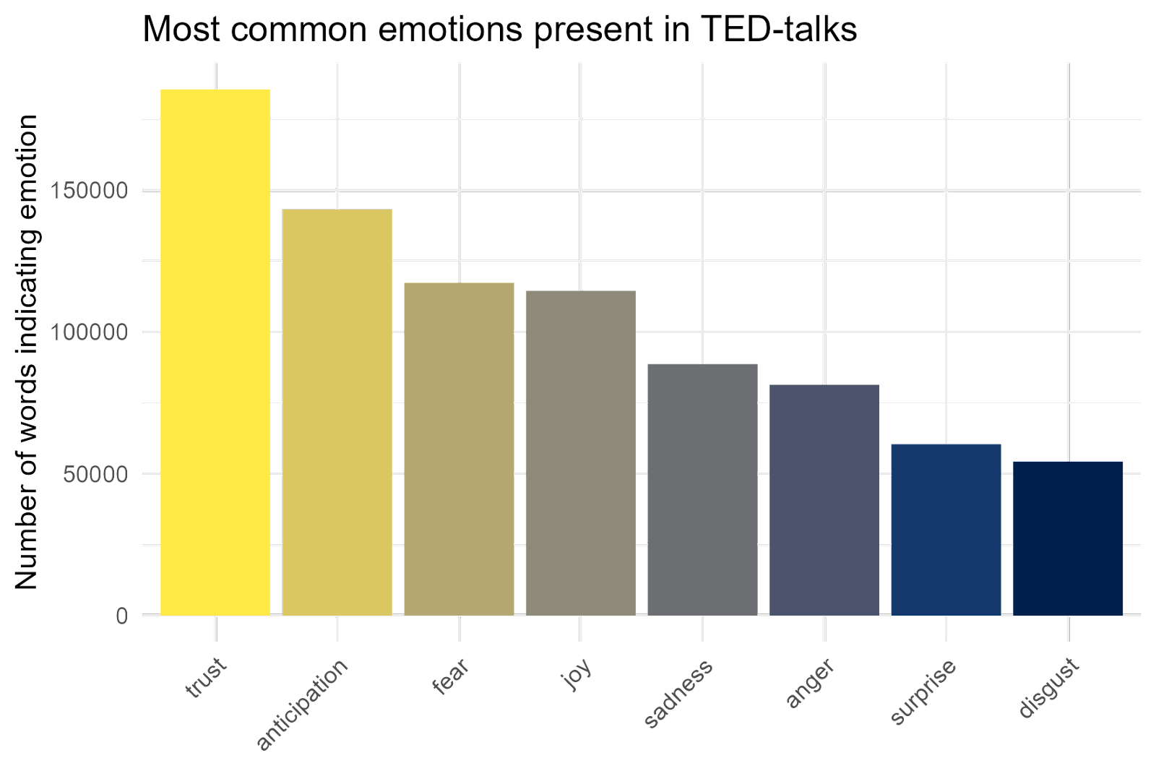
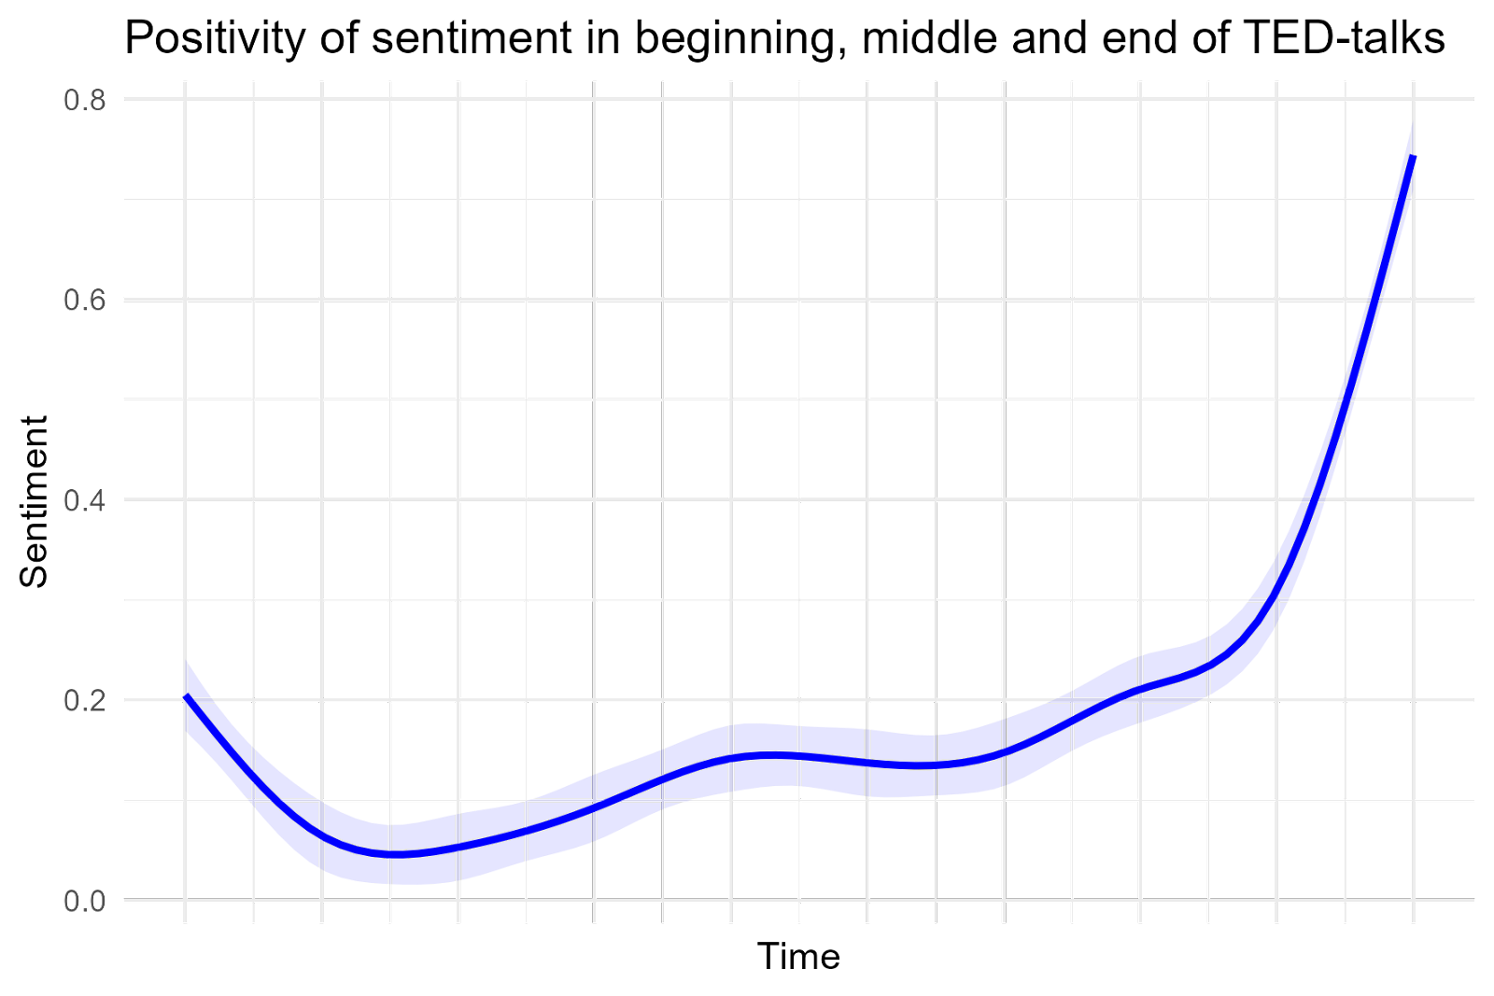
Is there a particularly prevalent emotion within TED-talks?
Is there a specific pattern to the positive and negative emotions within the talks?

